Slide 1
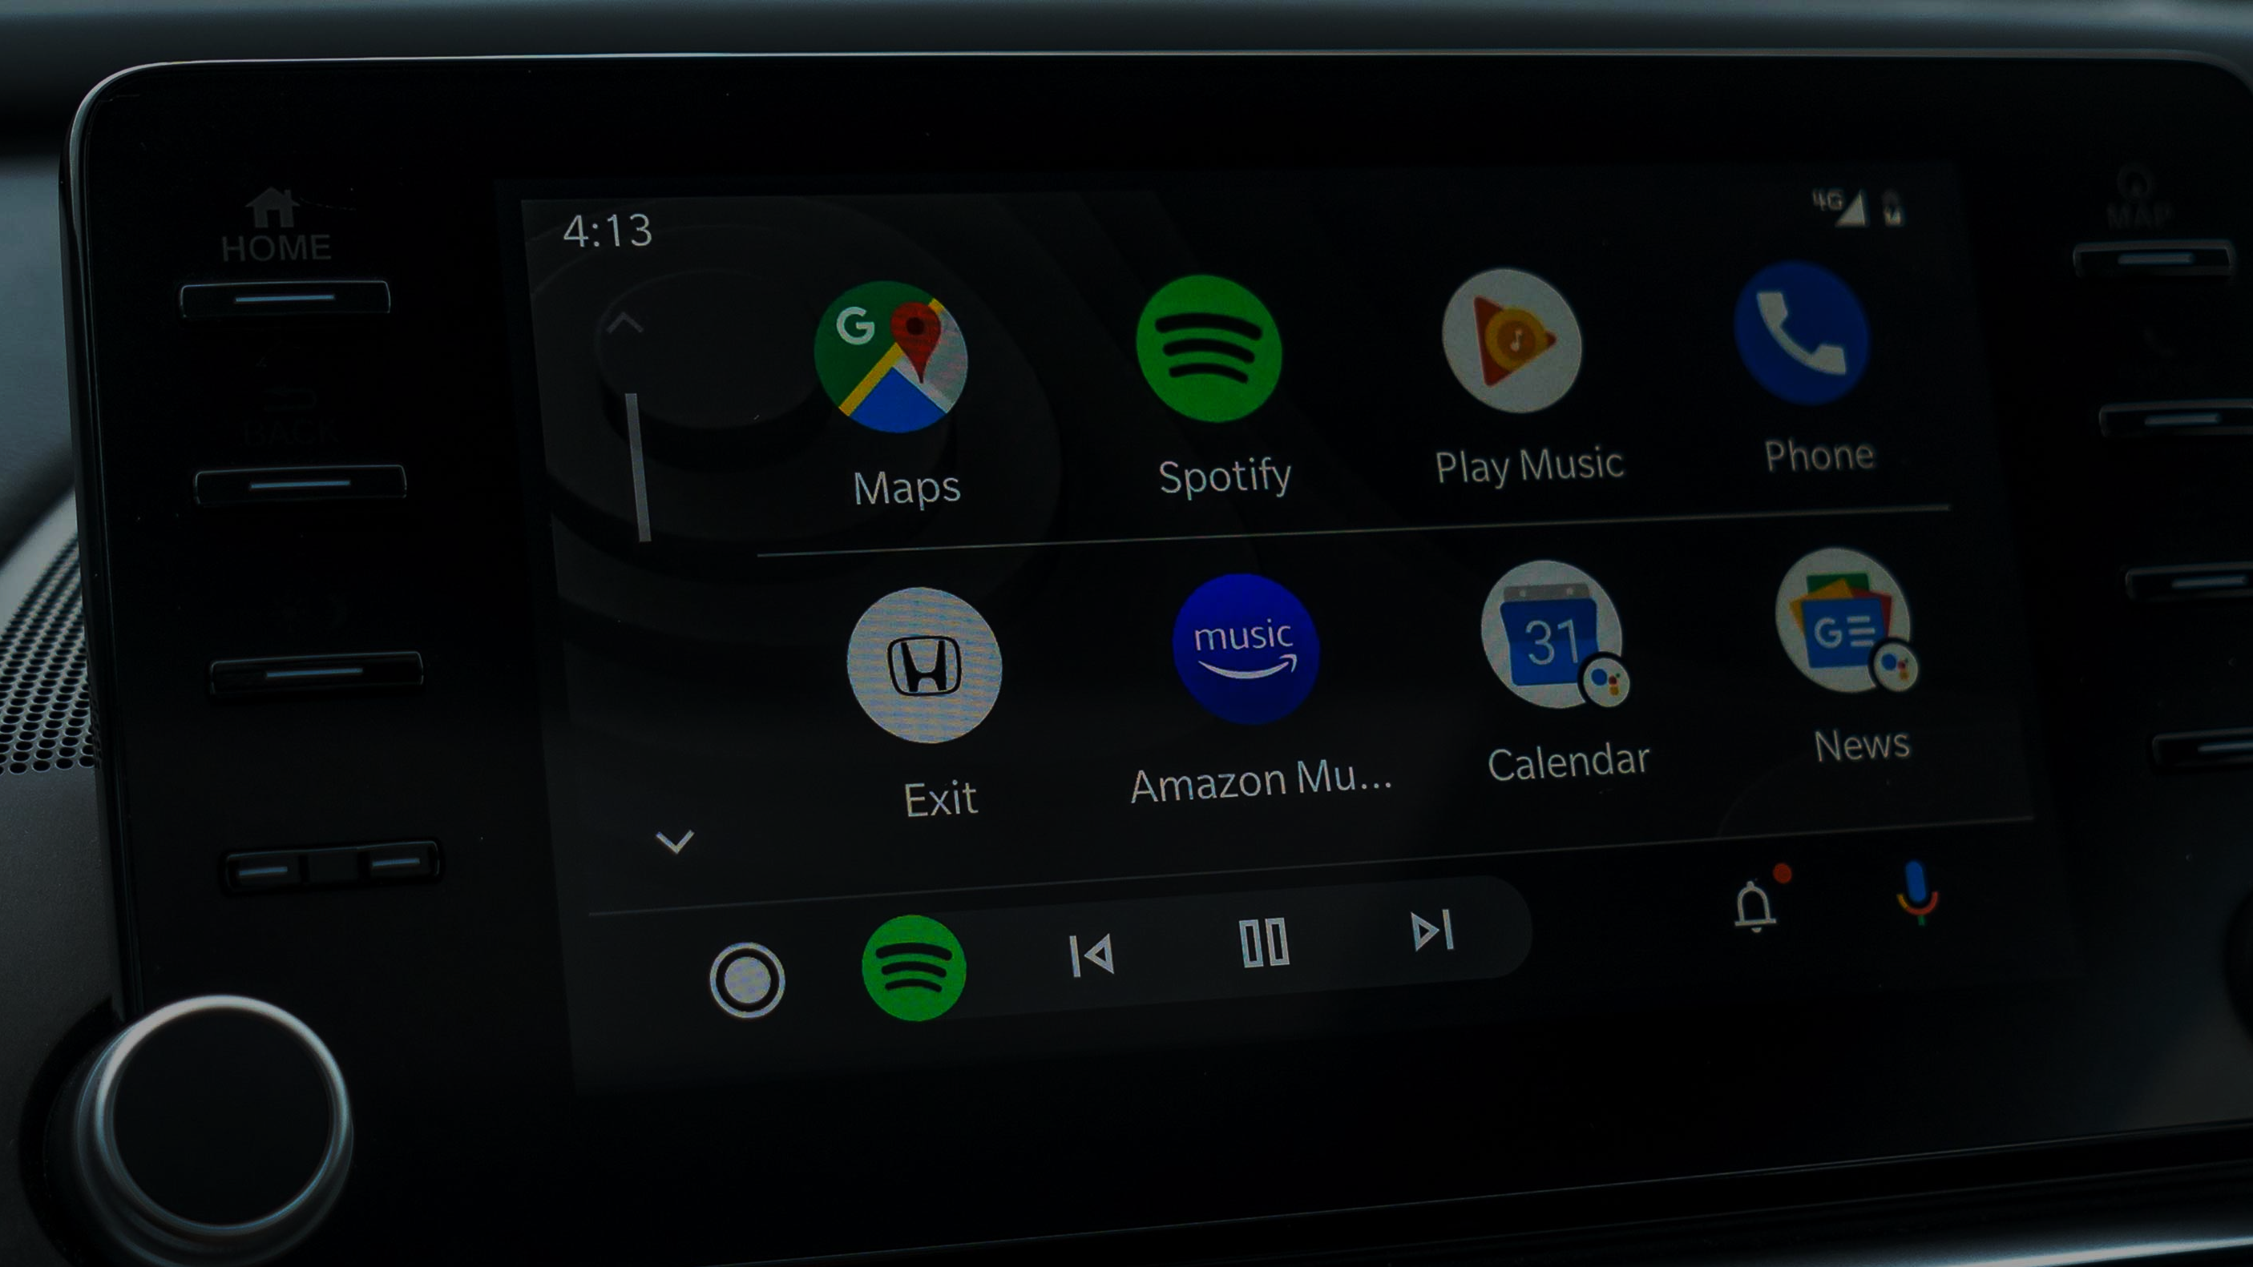
CarJam
A car-jamming music-playing energy-level sentimental-analysis music-picker
Ian Webster | Jonathan Yan | Tong Yin Han | David Song

Slide 2
Background Information
Introduction of large-screen car display added many features to the car
However, large touch screen displays provide distraction to the drivers, and increases the risk of serious car accident
In order to reduce accident, it would be preferred to reduce touch interaction as much as possible
Study indicates that listening to music “does not impair performance in a monotonous car-following task”, and “positively impact mood while driving, which can be used to affect state and safe behaviour”

Slide 3
Motivation
Jonathan likes to listen to the music when he is driving
Doesn’t want to pick songs while he is driving
Wants an app to be able to choose a random song based on his mood at the moment

Slide 4


Methodology
Raspberry Pi 3
Backend
Frontend
Audio blob
react-mic
User Input:
Speech audio
Multer
File storage
Google speech-to-text API
Google Natural Language API
Sentient Analysis
Output:
Selection of song(s)
Spotify API
Spotify embedded player

Slide 5
References
https://cdn.mobilesyrup.com/wp-content/uploads/2019/10/android-auto-header-2019.jpg
https://actslaw.com/dashboard-touch-screens-safety-hazard/
https://pubmed.ncbi.nlm.nih.gov/22176481/
https://www.sciencedirect.com/science/article/abs/pii/S136984781300079X

